Slide 1
INTRODUCTION

Slide 2
OPERATING SYSTEM
A program that acts as an intermediary between a user of a computer and the computer hardware.
Purpose:
  Execute user programs and make solving user problems easier
  Make the computer system convenient to use
  Use the computer hardware in an efficient manner

Slide 3
Computer system can be divided into four components:
  Hardware
  CPU, memory, I/O devices these – provide basic computing resources for system
  Operating system
    Controls and coordinates use of hardware among various applications and users
  Application programs
  -define the ways in which the system resources are used to solve the computing problems of the users
    Compilers, word processor, spread sheets, web browsers
    Users
    People, machines, other computers

Slide 4

Four Components of a Computer System

Slide 5
User View
For users who sit in front of PC and want convenience, ease of use and good performance
  Operating system is designed for convenience of user and don’t care about resource utilization
For mainframe or minicomputer
Os is designed for resource sharing it manages CPU time, memory and I/O. Keeps manage that no user get more than his fair share of time in time sharing.
Users of dedicate systems such as workstations have dedicated resources but frequently use shared resources from servers. Os is designed for resource utilization, such as printer.
Handheld computers are resource poor, optimized for usability and battery life
Some computers have little or no user interface, such as embedded computers in devices and automobiles

Slide 6
System View:
AS resource allocator
  Manages all resources
  Decides between conflicting requests for efficient and fair resource use.
  Involves allocation of resources through appropriate scheme
As control program
  Controls execution of programs to prevent errors and improper use of the computer
  Main concern is to control operation and control of I/O devices

Slide 7
KERNEL
Main part of OS
“The one program running at all times on the computer” is the kernel.
As OS has two parts 1) Shell 2) Kernel
Bootstrap program is loaded at power-up or reboot
  This is stored in ROM or EPROM, generally known as firmware(a storage place)
  Initializes all aspects of system. Load from secondary memory to main memory
  Loads operating system kernel and starts execution

Slide 8
COMPUTER-SYSTEM OPERATION
I/O devices and the CPU can execute concurrently as each device has a controller Each device controller is in charge of a particular device type. Device type is recognized by driver
Each device controller has a local buffer
CPU moves data from/to main memory to/from local buffers on interrupts to OS
Device controller informs CPU that it has finished by causing an interrupt

Slide 9
HOW INTERRUPT WORKS
Interrupt transfers control to the interrupt service routine generally, through the interrupt vector
Interrupt vector is a table that contains the addresses of all the service routines
Interrupt architecture must save the address of the interrupted instruction. It pushes running process into stack and execute interrupt first, after completion it resumes the paused process.
A trap or exception is a software-generated interrupt caused either by an error or a user request
An operating system is interrupt driven

Slide 10
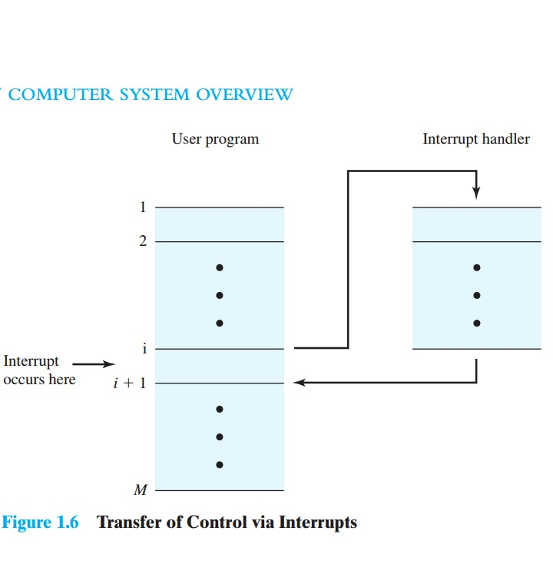
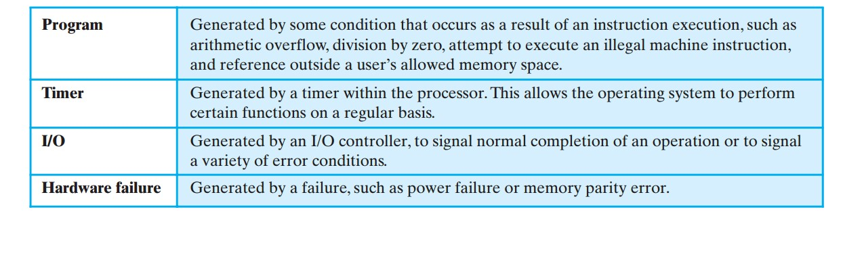

Slide 11
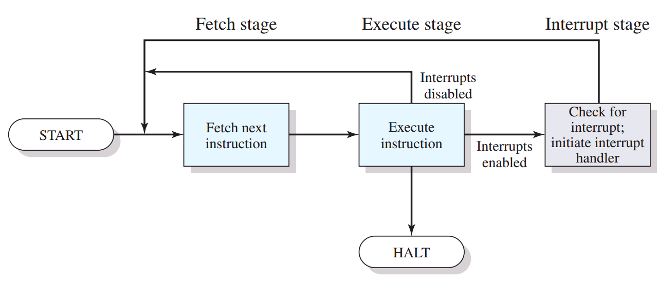
Interrupts are provided primarily as a way to improve processor utilization.
For example, most I/O devices are much slower than the processor. Suppose that the processor is transferring data to a printer using the instruction cycle.
For no interrupts: After each write operation, the processor must pause and remain idle until the printer catches up. The length of this pause may be on the order of many thousands or even millions of instruction cycles. Clearly, this is a very wasteful use of the processor.

Slide 12
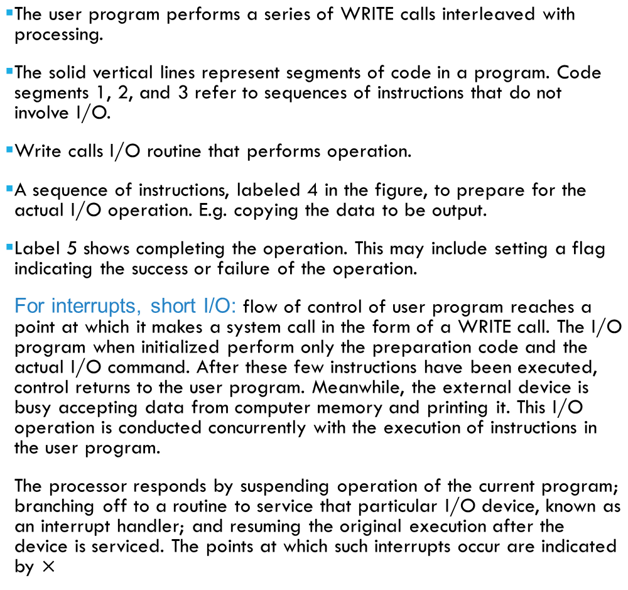
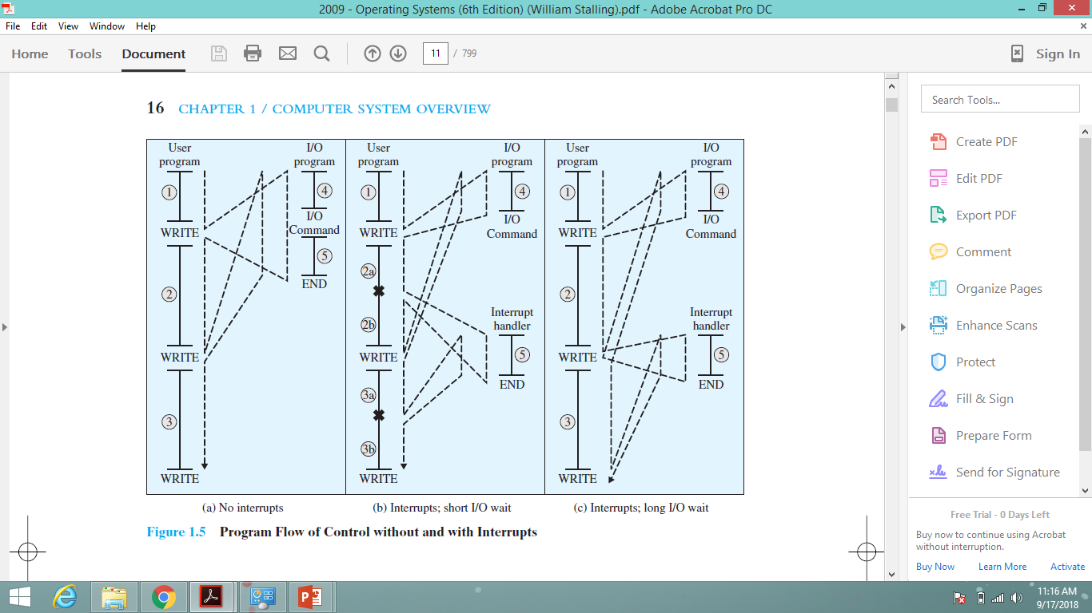

Slide 13
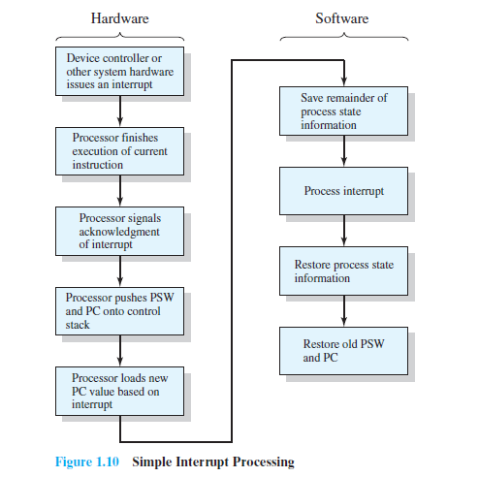


Slide 14
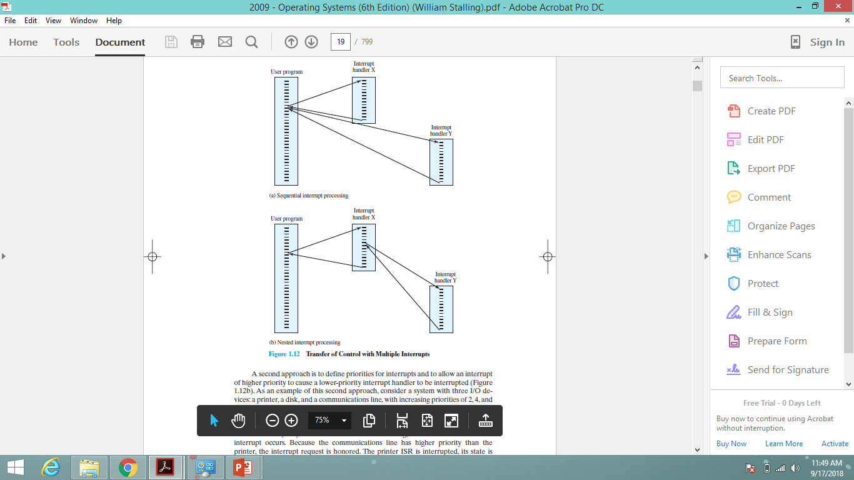

Slide 15
STORAGE STRUCTURE
Main memory – only large storage media that the CPU can access directly
  Random access
  Typically volatile
Secondary storage – extension of main memory that provides large nonvolatile storage capacity
Hard disks – rigid metal or glass platters covered with magnetic recording material
  Disk surface is logically divided into tracks, which are subdivided into sectors
  The disk controller determines the logical interaction between the device and the computer
Solid-state disks – faster than hard disks, nonvolatile
  Various technologies
  Becoming more popular

Slide 16
STORAGE HIERARCHY
Storage systems organized in hierarchy
  Speed
  Cost
  Volatility
Caching – copying information into faster storage system; main memory can be viewed as a cache for secondary storage
Device Driver for each device controller to manage I/O
  Provides uniform interface between controller and kernel

Slide 17

STORAGE-DEVICE HIERARCHY

Slide 18
COMPUTER-SYSTEM ARCHITECTURE
Most systems use a single general-purpose processor
  Most systems have special-purpose processors as well
Multiprocessors systems growing in use and importance
  Also known as parallel systems, tightly-coupled systems
  Advantages include:
    Increased throughput: more computation performed in less time
    Economy of scale: resources are shared for multiprocessors leads to economy
    Increased reliability – graceful degradation or fault tolerance
  Two types:
    Asymmetric Multiprocessing – each processor is assigned a specific task.
    Symmetric Multiprocessing – each processor performs all tasks

Slide 19

SYMMETRIC MULTIPROCESSING ARCHITECTURE

Slide 20

A DUAL-CORE DESIGN
Multi-chip and multicore
Systems containing all chips
  Chassis containing multiple separate systems

Slide 21
CLUSTERED SYSTEMS
A cluster is a set of loosely or tightly connected computers that work together so node that, in many respects, they can be viewed as a single system. Clusters have each set to perform the same task, controlled and scheduled by software.
The components of a cluster are usually connected to each other through fast local area networks, with each node (computer used as a server) running its own instance of an operating system. Clusters are usually deployed to improve performance and availability over that of a single computer, while typically being much more cost-effective than single computer
  Provides a high-availability service
  Asymmetric clustering
  Asymmetric clustering is when having a cluster of servers running applications where one server runs the applications as the other servers remain on standby. All the partitions on the servers are dynamically declared and are usually running on a single cluster at a time. Each server cluster is task specific, and only relevant tasks will be routed to the specific cluster.
  Symmetric clustering has multiple nodes running applications, monitoring each other
  Some clusters are for high-performance computing (HPC)
    Applications must be written to use parallelization

Slide 22

CLUSTERED SYSTEMS

Slide 23
OPERATING-SYSTEM OPERATIONS
Interrupt driven (hardware and software)
  Hardware interrupt by one of the devices
  Software interrupt (exception or trap):
    Software error (e.g., division by zero)
    Request for operating system service
    Other process problems include infinite loop, processes modifying each other or the operating system

Slide 24
OPERATING-SYSTEM OPERATIONS (CONT.)
Dual-mode operation allows OS to protect itself and other system components
  User mode and kernel mode
  Mode bit provided by hardware
    Provides ability to distinguish when system is running user code or kernel code
    Some instructions designated as privileged, only executable in kernel mode
    System call changes mode to kernel, return from call resets it to user
Increasingly CPUs support multi-mode operations
  i.e. virtual machine manager (VMM) mode for guest VMs

Slide 25

TRANSITION FROM USER TO KERNEL MODE
Timer to prevent infinite loop / process hogging resources
  Timer is set to interrupt the computer after some time period
  Keep a counter that is decremented by the physical clock.
  Operating system set the counter (privileged instruction)
  When counter zero generate an interrupt
  Set up before scheduling process to regain control or terminate program that exceeds allotted time

Slide 26
PROCESS MANAGEMENT
A process is a program in execution. It is a unit of work within the system. Program is a passive entity, process is an active entity.
Process needs resources to accomplish its task
  CPU, memory, I/O, files
  Initialization data
Process termination requires reclaim of any reusable resources
Single-threaded process has one program counter specifying location of next instruction to execute
  Process executes instructions sequentially, one at a time, until completion
Multi-threaded process has one program counter per thread
Typically system has many processes, some user, some operating system running concurrently on one or more CPUs
  Concurrency by multiplexing the CPUs among the processes / threads

Slide 27
PROCESS MANAGEMENT ACTIVITIES
The operating system is responsible for the following activities in connection with process management:
Creating and deleting both user and system processes
Suspending and resuming processes
Providing mechanisms for process synchronization
Providing mechanisms for process communication
Scheduling processes and threads on the CPUs

Slide 28
MEMORY MANAGEMENT
To execute a program all (or part) of the instructions must be in memory
All (or part) of the data that is needed by the program must be in memory.
Memory management determines what is in memory and when
  Optimizing CPU utilization and computer response to users
Memory management activities
  Keeping track of which parts of memory are currently being used and by whom
  Deciding which processes (or parts thereof) and data to move into and out of memory involves segmentation fragmentation
  Allocating and deallocating memory space as needed

Slide 29
STORAGE MANAGEMENT
OS provides uniform, logical view of information storage
  Abstracts physical properties to logical storage unit - file
  Each medium is controlled by device (i.e., disk drive, tape drive)
    Varying properties include access speed, capacity, data-transfer rate, access method (sequential or random)
File-System management
  Files usually organized into directories
  Access control on most systems to determine who can access what
  OS activities include
    Creating and deleting files and directories
    Supporting primitives to manipulate files and directories
    Mapping files onto secondary storage
    Backup files onto stable (non-volatile) storage media

Slide 30
MASS-STORAGE MANAGEMENT
Usually disks used to store data that does not fit in main memory or data that must be kept for a “long” period of time
Proper management is of central importance
Entire speed of computer operation hinges on disk subsystem and its algorithms
OS activities
  Free-space management
  Storage allocation
  Disk scheduling
Some storage need not be fast
  Tertiary storage includes optical storage, magnetic tape
  Still must be managed – by OS or applications
  Varies between WORM (write-once, read-many-times) and RW (read-write)

Slide 31
I/O COMMUNICATION TECHNIQUES
Three techniques are possible for I/O operations: • Programmed I/O
• Interrupt-driven I/O
• Direct memory access (DMA)
Programmed I/O
When the processor is executing a program and encounters an instruction relating to I/O, it executes that instruction by issuing a command to the appropriate I/O module. In the case of programmed I/O, the I/O module performs the requested action and then sets the appropriate bits in the I/O status register but takes no further action to alert the processor. In particular, it does not interrupt the processor. Thus, after the I/O instruction is invoked, the processor must take some active role in determining when the I/O instruction is completed. For this purpose, the processor periodically checks the status of the I/O module until it finds that the operation is complete. With this technique, the processor is responsible for extracting data from main memory for output and storing data in main memory for input. I/O software is written in such a way that the processor executes instructions that give it direct control of the I/O operation, including sensing device status, sending a read or write command, and transferring the data.Thus, the instruction set includes I/O instructions in the following categories:
• Control: Used to activate an external device and tell it what to do. For example, a magnetic-tape unit may be instructed to rewind or to move forward one record.
• Status: Used to test various status conditions associated with an I/O module and its peripherals.
• Transfer: Used to read and/or write data between processor registers and external devices.

Slide 32
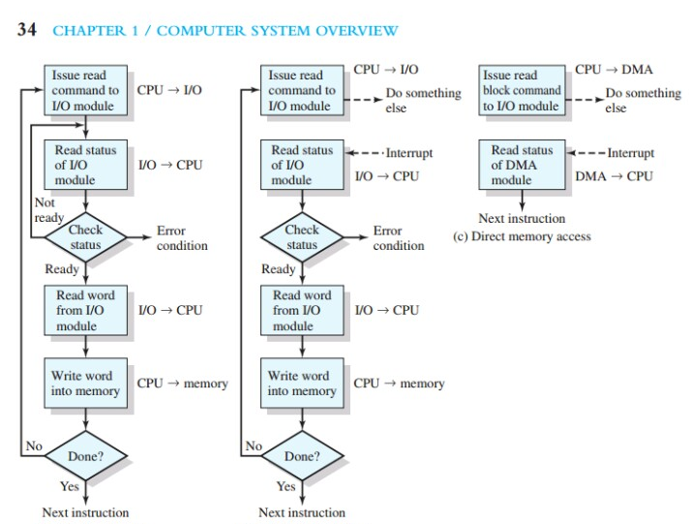

Slide 33
INTERRUPT-DRIVEN I/O
With programmed I/O, the processor has to wait a long time for the I/O module of concern to be ready for either reception or transmission of more data. The processor, while waiting, must repeatedly interrogate the status of the I/O module. As a result, the performance level of the entire system is severely degraded.
An alternative is for the processor to issue an I/O command to a module and then go on to do some other useful work.The I/O module will then interrupt the processor to request service when it is ready to exchange data with the processor.The processor then executes the data transfer, as before, and then resumes its former processing.
Let us consider how this works, first from the point of view of the I/O module. For input, the I/O module receives a READ command from the processor. The I/O module then proceeds to read data in from an associated peripheral. Once the data are in the module’s data register, the module signals an interrupt to the processor over a control line. The module then waits until its data are requested by the processor. When the request is made, the module places its data on the data bus and is then ready for another I/O operation.

Slide 34
Figure 1.19b shows the use of interrupt-driven I/O for reading in a block of
data. Interrupt-driven I/O is more efficient than programmed I/O because it eliminates needless waiting. However, interrupt-driven I/O still consumes a lot of processor time, because every word of data that goes from memory to I/O module or from I/O module to memory must pass through the processor.

Slide 35
DIRECT MEMORY ACCESS
Interrupt-driven I/O, though more efficient than simple programmed I/O, still requires the active intervention of the processor to transfer data between memory and an I/O module, and any data transfer must traverse a path through the processor.
Thus both of these forms of I/O suffer from two inherent drawbacks:
1. The I/O transfer rate is limited by the speed with which the processor can test
and service a device.
2. The processor is tied up in managing an I/O transfer; a number of instructions
must be executed for each I/O transfer.
When large volumes of data are to be moved, a more efficient technique is required: direct memory access (DMA). The DMA function can be performed by a separate module on the system bus or it can be incorporated into an I/O module. In either case, the technique works as follows. When the processor wishes to read or write a block of data, it issues a command to the DMA module, by sending to the DMA module the following information:
Whether a read or write is requested
The address of the I/O device involved

Slide 36
The starting location in memory to read data from or write data to
The number of words to be read or written
The processor then continues with other work. It has delegated this I/O operation to the DMA module, and that module will take care of it. The DMA module transfers the entire block of data, one word at a time, directly to or from memory without going through the processor. When the transfer is complete, the DMA module sends an interrupt signal to the processor. Thus the processor is involved only at the beginning and end of the transfer (Figure 1.19c).
The DMA module needs to take control of the bus to transfer data to and from memory. Because of this competition for bus usage, there may be times when the processor needs the bus and must wait for the DMA module. Note that this is not an interrupt; the processor does not save a context and do something else.
Rather, the processor pauses for one bus cycle (the time it takes to transfer on word across the bus). The overall effect is to cause the processor to execute more slowly during a DMA transfer when processor access to the bus is required. Nevertheless, for a multiple-word I/O transfer, DMA is far more efficient than interruptdriven or programmed I/O.

Slide 37

MIGRATION OF DATA “A” FROM DISK TO REGISTER
Multitasking environments must be careful to use most recent value, no matter where it is stored in the storage hierarchy
Multiprocessor environment must provide cache coherency in hardware such that all CPUs have the most recent value in their cache
Distributed environment situation even more complex
  Several copies of a datum can exist
  Various solutions covered in Chapter 17

Slide 38
I/O SUBSYSTEM
One purpose of OS is to hide peculiarities of hardware devices from the user
I/O subsystem responsible for
  Memory management of I/O including buffering (storing data temporarily while it is being transferred), caching (storing parts of data in faster storage for performance), spooling (the overlapping of output of one job with input of other jobs)
  General device-driver interface
  Drivers for specific hardware devices

Slide 39
PROTECTION AND SECURITY
Protection – any mechanism for controlling access of processes or users to resources defined by the OS
Security – defense of the system against internal and external attacks
  Huge range, including denial-of-service, worms, viruses, identity theft, theft of service
Systems generally first distinguish among users, to determine who can do what
  User identities (user IDs, security IDs) include name and associated number, one per user
  User ID then associated with all files, processes of that user to determine access control
  Group identifier (group ID) allows set of users to be defined and controls managed, then also associated with each process, file
  Privilege escalation allows user to change to effective ID with more rights

Slide 40



KERNEL DATA STRUCTURES
Many similar to standard programming data structures
Singly linked list
Doubly linked list
Circular linked list

Slide 41

KERNEL DATA STRUCTURES
Binary search tree
left <= right
  Search performance is O(n)
  Balanced binary search tree is O(lg n)

